Slide 1

ISE 218: Fundamentals of Information Technology Unit 3: Basics of Computer Architecture
Spring 2025
Instructor: Abid Malik
co-Instructor: Xinrui Yu

Slide 2
Objectives
Learn the components common to every modern computer system.
Be able to explain how each component contributes to program execution.
Understand a simple architecture invented to illuminate these basic concepts, and how it relates to some real architectures.
Know how the program assembly process works.

Slide 3
CPU Basics
Unit 1 presented a general overview of computer systems.
In Unit 2, we discussed how data is stored and manipulated by various computer system components.
Having this background, we can now start to understand how computer components work, and how they fit together to create useful computer systems.
The computer’s CPU fetches, decodes and executes program instructions.
The two principal parts of the CPU are the datapath and the control unit.
The datapath consists of an arithmetic/logic unit and storage units (registers) that are interconnected by a data bus that is also connected to main memory.
Various CPU components perform sequenced operations according to electrical signals provided by its control unit.

Slide 4
CPU Basics
Registers hold data that can be readily accessed by the CPU.
The arithmetic/logic unit (ALU) carries out logical and arithmetic operations as directed by the control unit.
The control unit determines which actions to carry out according to the values in a program counter register and a status register.
The program counter contains the memory address of the next instruction to execute.
The status register records any special circumstances, such as whether the CPU performed a calculation that caused an overflow.

Slide 5
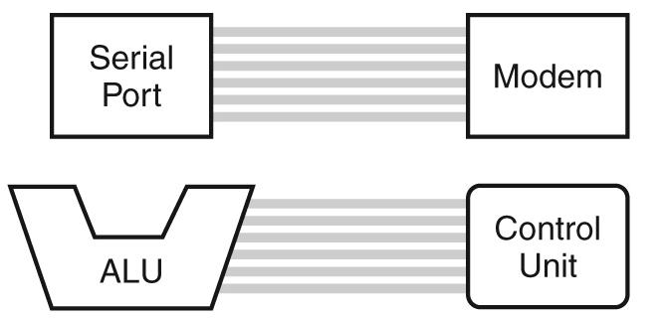
The System Bus
The CPU shares data with other system components by way of a data bus (what problems could this sharing cause?)
A bus is a set of wires that simultaneously convey a single bit along each line.
Two types of buses are commonly found in computer systems: point-to-point and multipoint buses.
These are point-to-point buses →
A multi-point bus has multiple entrances/exits

Slide 6
The System Bus
Buses are generally slower than CPUs and certain other components like the main memory
What problems/issues could this speed difference cause?
Communications bottleneck
Buses consist of data lines, control lines, and address lines.
While the data lines convey bits from one device to another, control lines determine the direction of data flow, and when each device can access the bus.
Address lines determine the location of the source or destination of the data.

Slide 7
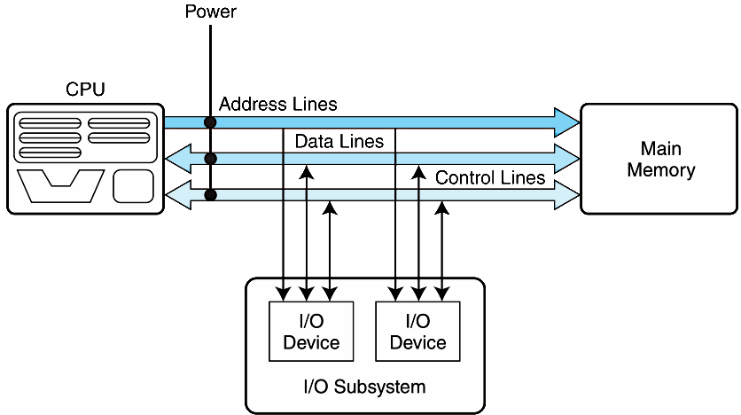
The System Bus

Slide 8
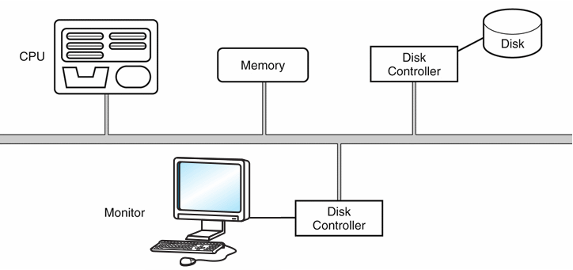
The System Bus
A multipoint bus is shown below.
Because a multipoint bus is a shared resource, access to it is controlled through protocols, which are built into the hardware.

Slide 9
The System Bus
In a master-slave configuration, where more than one device can be in control of the bus, concurrent bus master requests must be arbitrated.
Four categories of bus arbitration are:
Daisy chain: permissions are passed from the highest-priority device to the lowest. Simple, but starvation is a possibility.
Centralized parallel: each device is directly connected to an arbitration circuit that selects who gets the bus.
Distributed using self-detection: devices use priorities to decide among themselves which gets the bus.
Distributed using collision-detection: any device can try to use the bus. If its data collides with the data of another device, it tries again.

Slide 10
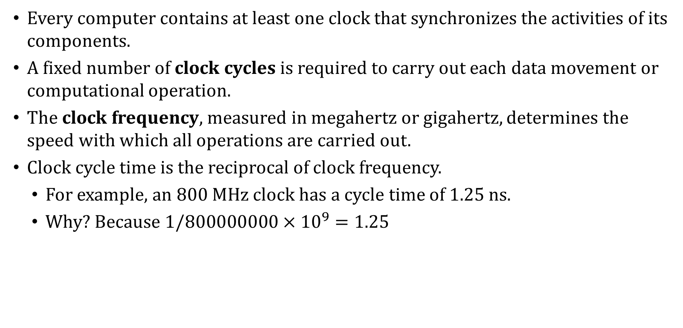
Clocks
Every computer contains at least one clock that synchronizes the activities of its components.
A fixed number of clock cycles is required to carry out each data movement or computational operation.
The clock frequency, measured in megahertz or gigahertz, determines the speed with which all operations are carried out.
Clock cycle time is the reciprocal of clock frequency.
For example, an 800 MHz clock has a cycle time of 1.25 ns.
Why? Because $1/800000000×{10}^{9}=1.25$

Slide 11
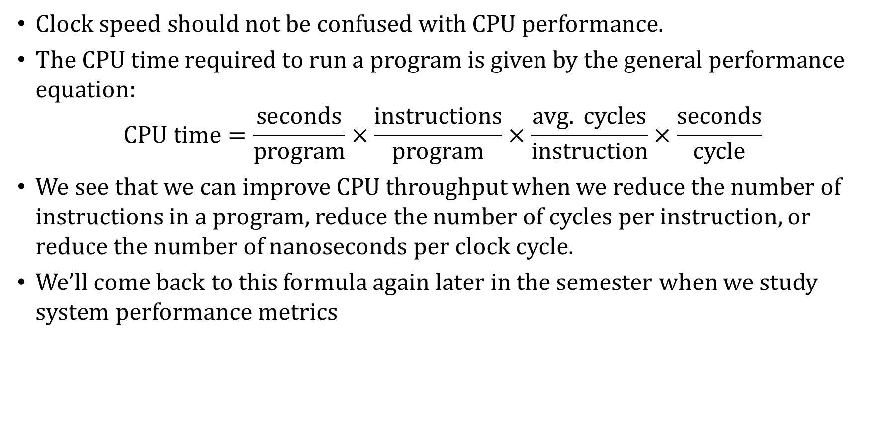
Clocks
Clock speed should not be confused with CPU performance.
The CPU time required to run a program is given by the general performance equation:
$$CPU time=\frac{seconds}{program}×\frac{instructions}{program}×\frac{avg. cycles}{instruction}×\frac{seconds}{cycle}$$
We see that we can improve CPU throughput when we reduce the number of instructions in a program, reduce the number of cycles per instruction, or reduce the number of nanoseconds per clock cycle.
We’ll come back to this formula again later in the semester when we study system performance metrics

Slide 12

What is Overclocking?
Overclocking involves running a computer component at a higher clock speed than intended
The CPU, system bus and GPU (graphics processing unit) can all be overclocked
The idea is to eke out more performance from the computer, at the expense of generating more heat, which can damage components
Is it worth it to overclock the CPU? Probably not, nowadays.
With computer gaming, for example, the bottleneck is more likely to be the GPU, so we could overclock that
And only then if you are playing a really graphics-intensive game at very high resolution

Slide 13
The Input/Output Subsystem
A computer communicates with the outside world through its input/output (I/O) subsystem.
I/O devices connect to the CPU through various interfaces.
I/O can be instruction-based, where the CPU has a specialized I/O instruction set.
I/O can be memory-mapped, where the I/O device behaves like main memory from CPU’s point of view.
Registers in the I/O device’s interface are mapped to memory cells in the main memory
CPU reads/writes a memory cell to communicate with the device

Slide 14
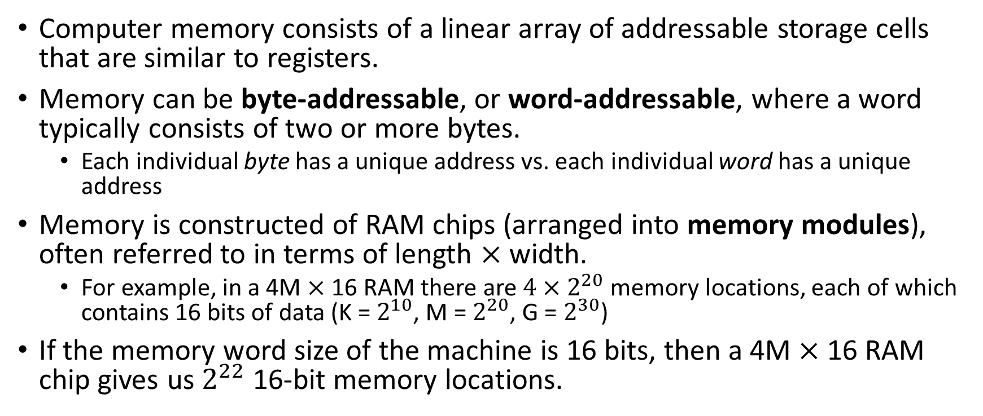
Memory Organization
Computer memory consists of a linear array of addressable storage cells that are similar to registers.
Memory can be byte-addressable, or word-addressable, where a word typically consists of two or more bytes.
Each individual byte has a unique address vs. each individual word has a unique address
Memory is constructed of RAM chips (arranged into memory modules), often referred to in terms of length $×$ width.
For example, in a 4M $×$ 16 RAM there are $4×2^{20}$ memory locations, each of which contains 16 bits of data (K = $2^{10}$, M = $2^{20}$, G = $2^{30}$)
If the memory word size of the machine is 16 bits, then a 4M $×$ 16 RAM chip gives us $2^{22}$ 16-bit memory locations.

Slide 15
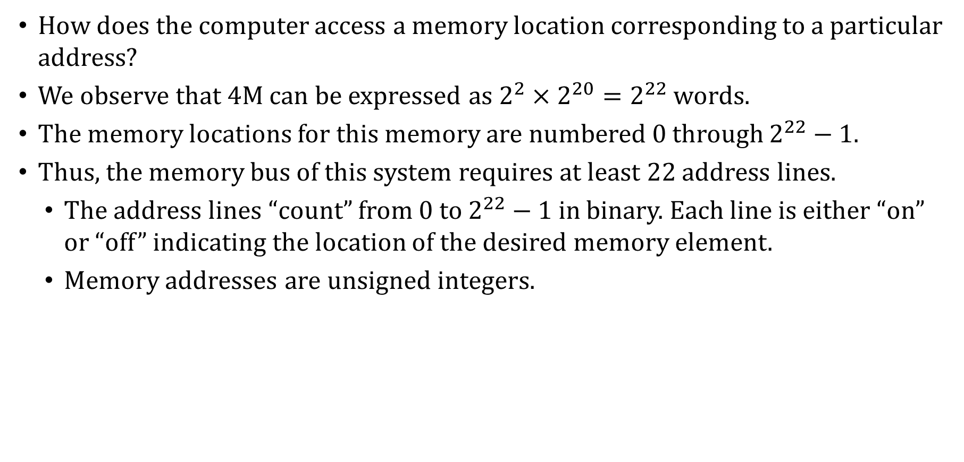
Memory Organization
How does the computer access a memory location corresponding to a particular address?
We observe that 4M can be expressed as $2^{2}×2^{20}=2^{22}$ words.
The memory locations for this memory are numbered 0 through $2^{22}−1$.
Thus, the memory bus of this system requires at least 22 address lines.
The address lines “count” from 0 to $2^{22}−1$ in binary. Each line is either “on” or “off” indicating the location of the desired memory element.
Memory addresses are unsigned integers.

Slide 16
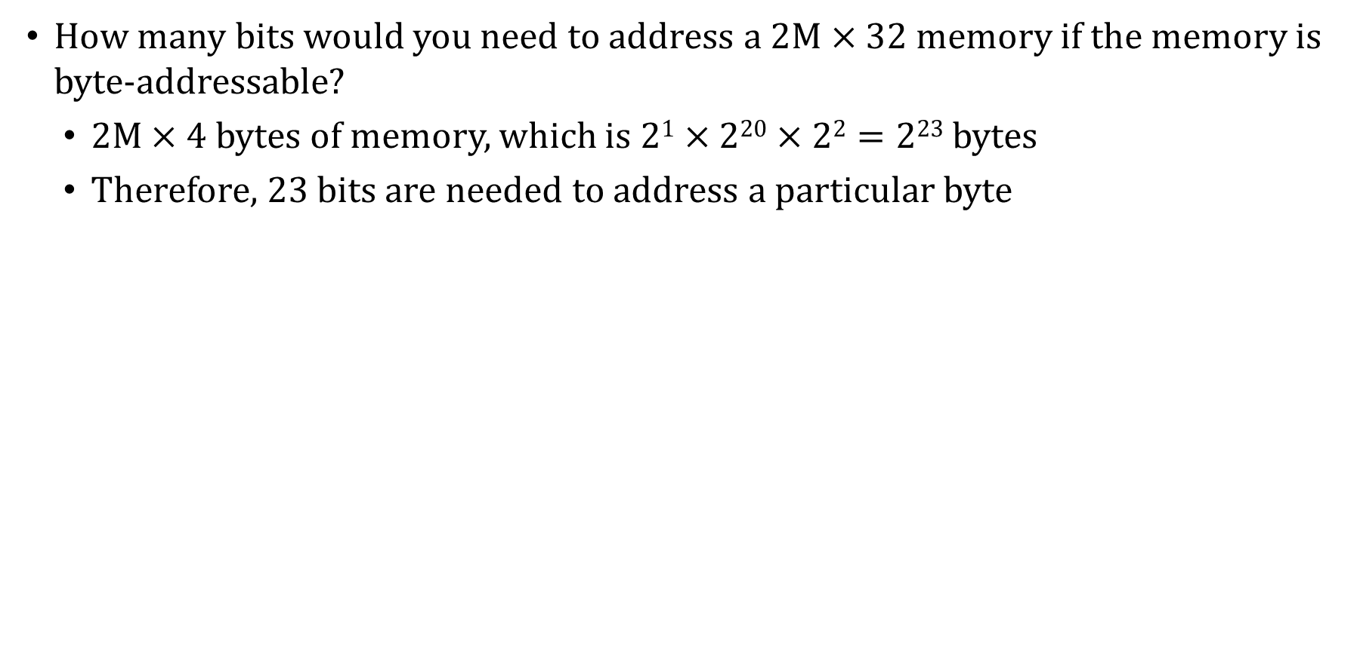
Memory Organization: Example #1
How many bits would you need to address a 2M $×$ 32 memory if the memory is byte-addressable?
2M $×$ 4 bytes of memory, which is $21×220×22=223$ bytes
Therefore, 23 bits are needed to address a particular byte

Slide 17
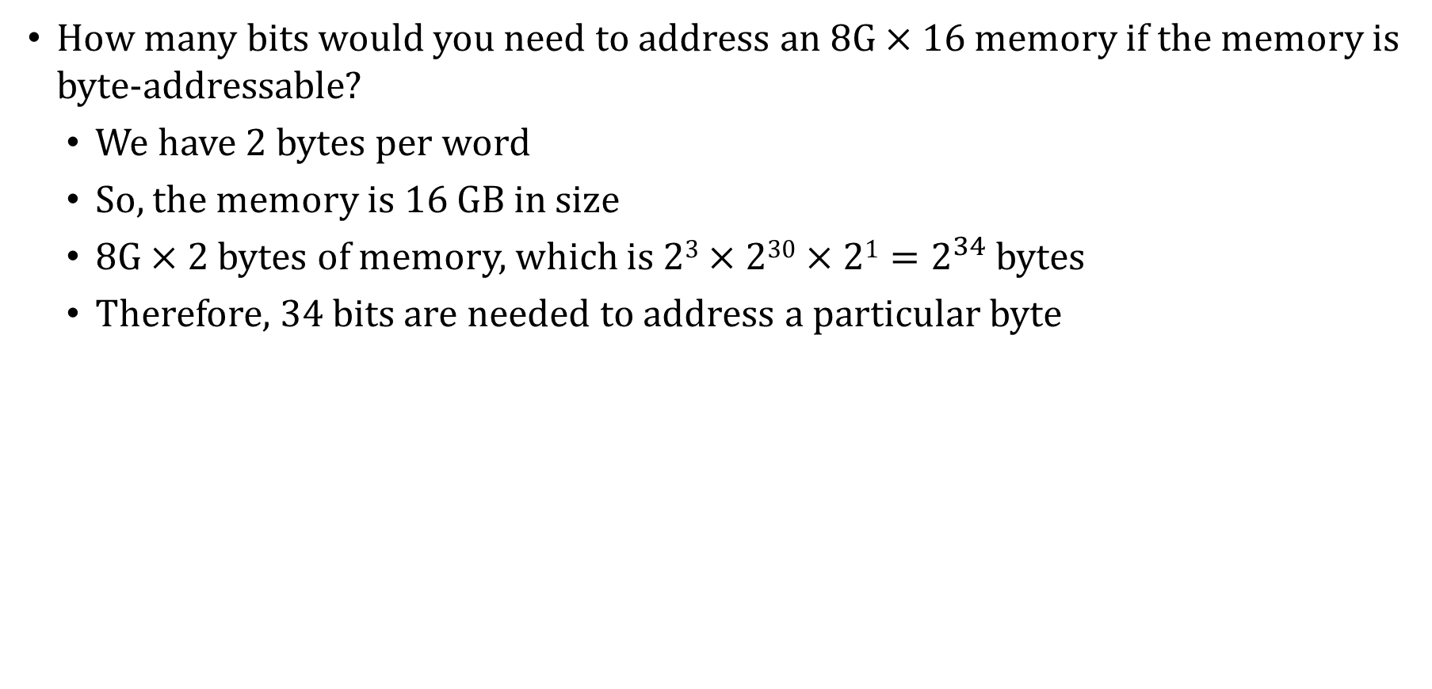
Memory Organization: Example #2
How many bits would you need to address an 8G $×$ 16 memory if the memory is byte-addressable?
We have 2 bytes per word
So, the memory is 16 GB in size
8G $×$ 2 bytes of memory, which is $23×230×21=2^{34}$ bytes
Therefore, 34 bits are needed to address a particular byte

Slide 18
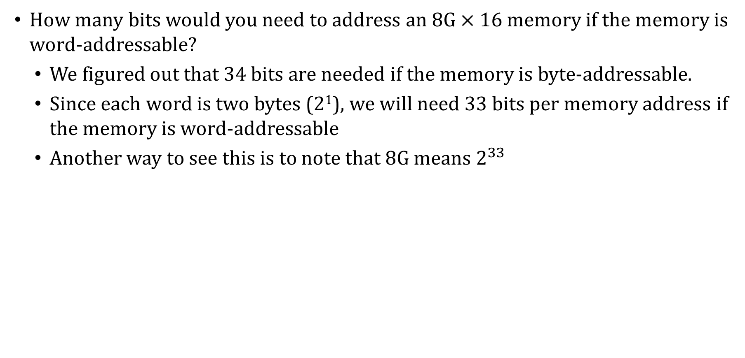
Memory Organization: Example #3
How many bits would you need to address an 8G $×$ 16 memory if the memory is word-addressable?
We figured out that 34 bits are needed if the memory is byte-addressable.
Since each word is two bytes (2¹), we will need 33 bits per memory address if the memory is word-addressable
Another way to see this is to note that 8G means $2^{33}$

Slide 19
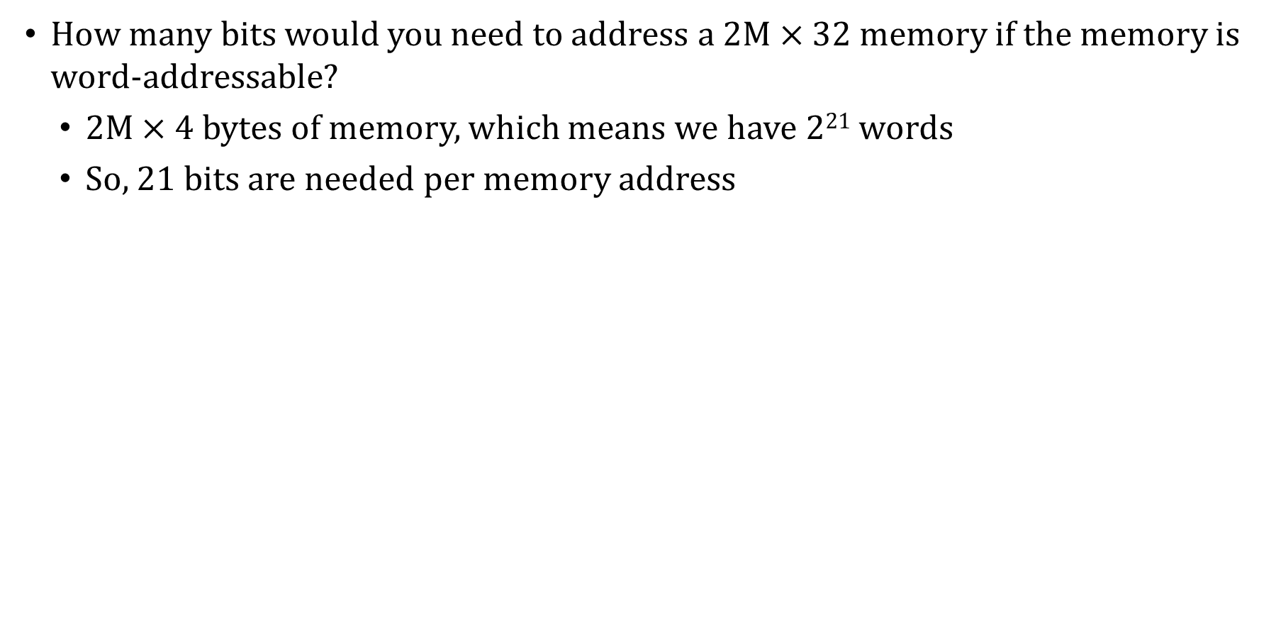
Memory Organization: Example #4
How many bits would you need to address a 2M $×$ 32 memory if the memory is word-addressable?
2M $×$ 4 bytes of memory, which means we have 2²¹ words
So, 21 bits are needed per memory address

Slide 20
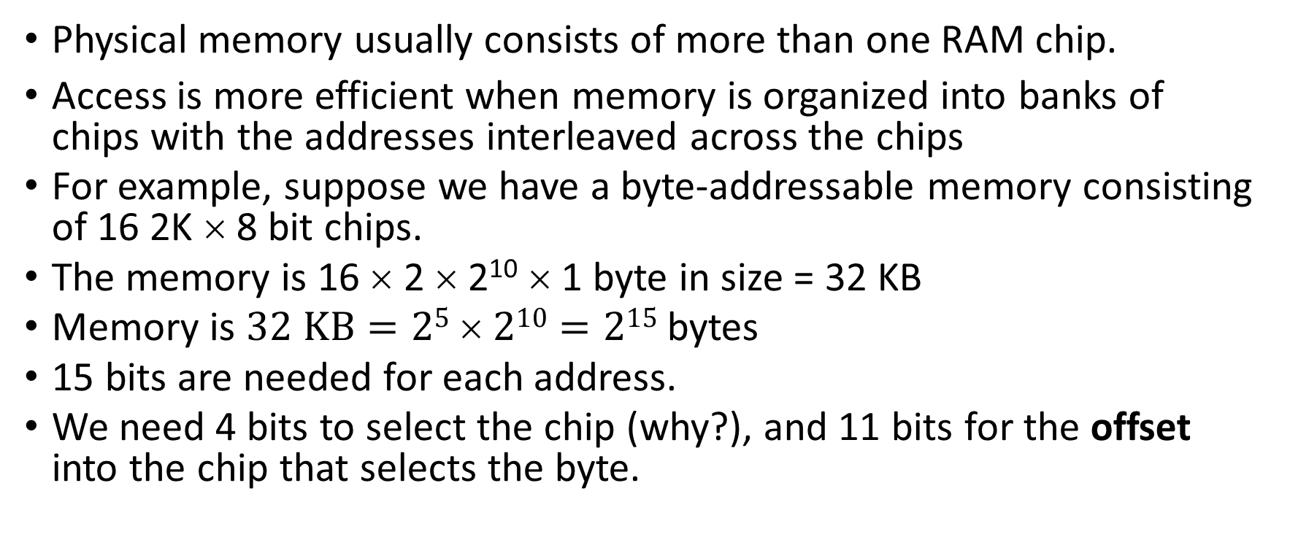
Memory Organization: Example #5
Physical memory usually consists of more than one RAM chip.
Access is more efficient when memory is organized into banks of chips with the addresses interleaved across the chips
For example, suppose we have a byte-addressable memory consisting of 16 2K × 8 bit chips.
The memory is 16 × 2 × 2¹⁰ × 1 byte in size = 32 KB
Memory is $32 KB=25  210=215$ bytes
15 bits are needed for each address.
We need 4 bits to select the chip (why?), and 11 bits for the offset into the chip that selects the byte.

Slide 21
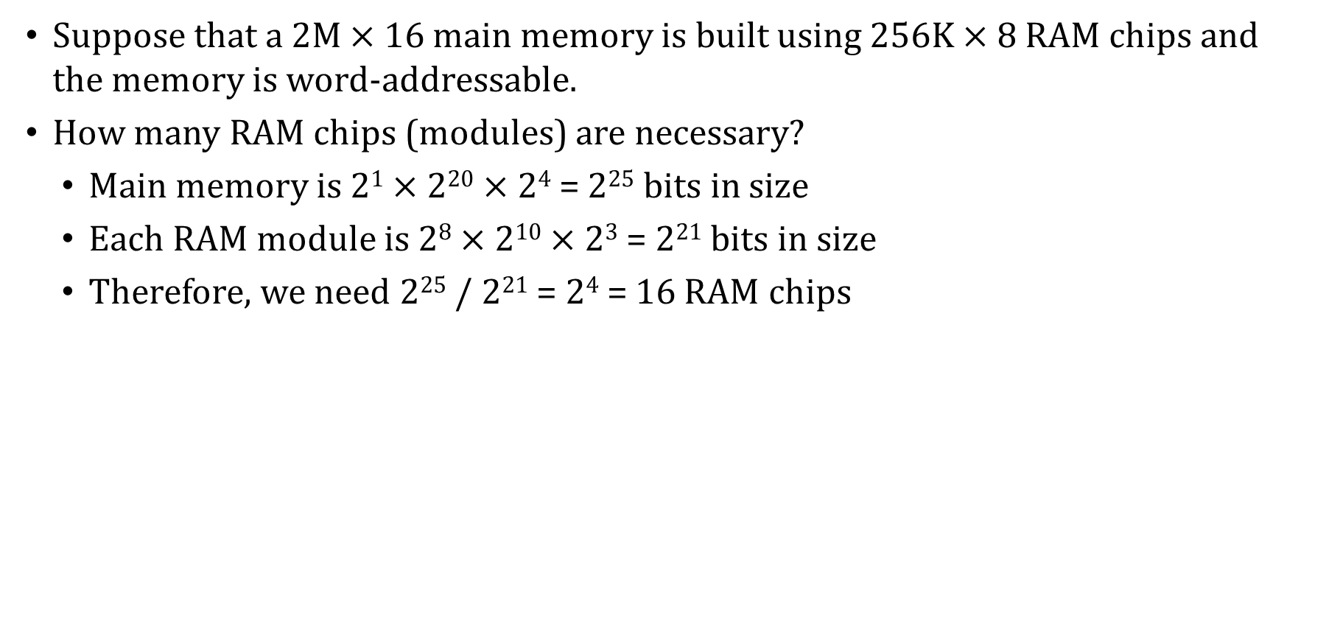
Memory Organization: Example #6
Suppose that a 2M $×$ 16 main memory is built using 256K $×$ 8 RAM chips and the memory is word-addressable.
How many RAM chips (modules) are necessary?
Main memory is 2¹ $×$ 2²⁰ $×$ 2⁴ = 2²⁵ bits in size
Each RAM module is 2⁸ $×$ 2¹⁰ $×$ 2³ = 2²¹ bits in size
Therefore, we need 2²⁵ / 2²¹ = 2⁴ = 16 RAM chips

Slide 22
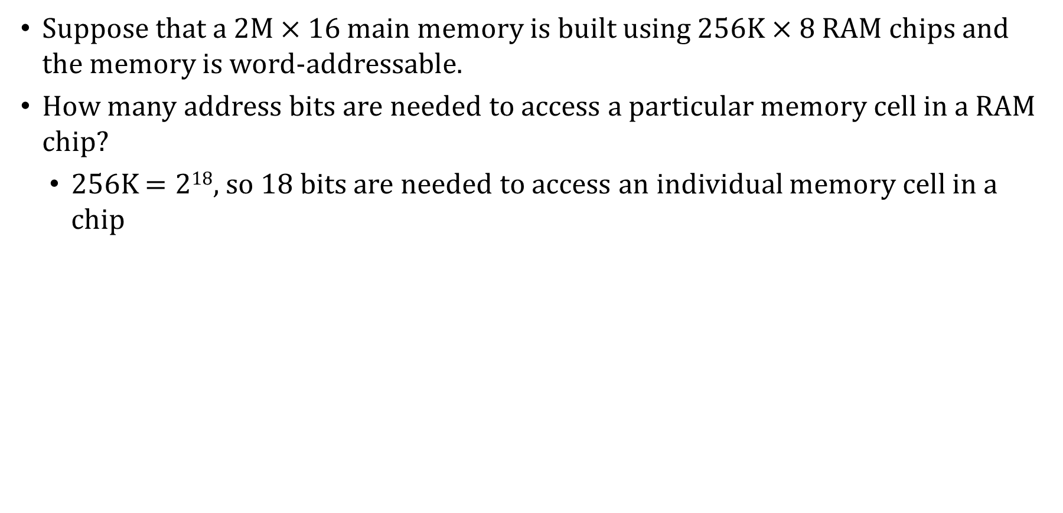
Memory Organization: Example #7
Suppose that a 2M $×$ 16 main memory is built using 256K $×$ 8 RAM chips and the memory is word-addressable.
How many address bits are needed to access a particular memory cell in a RAM chip?
256K $=218$, so 18 bits are needed to access an individual memory cell in a chip

Slide 23
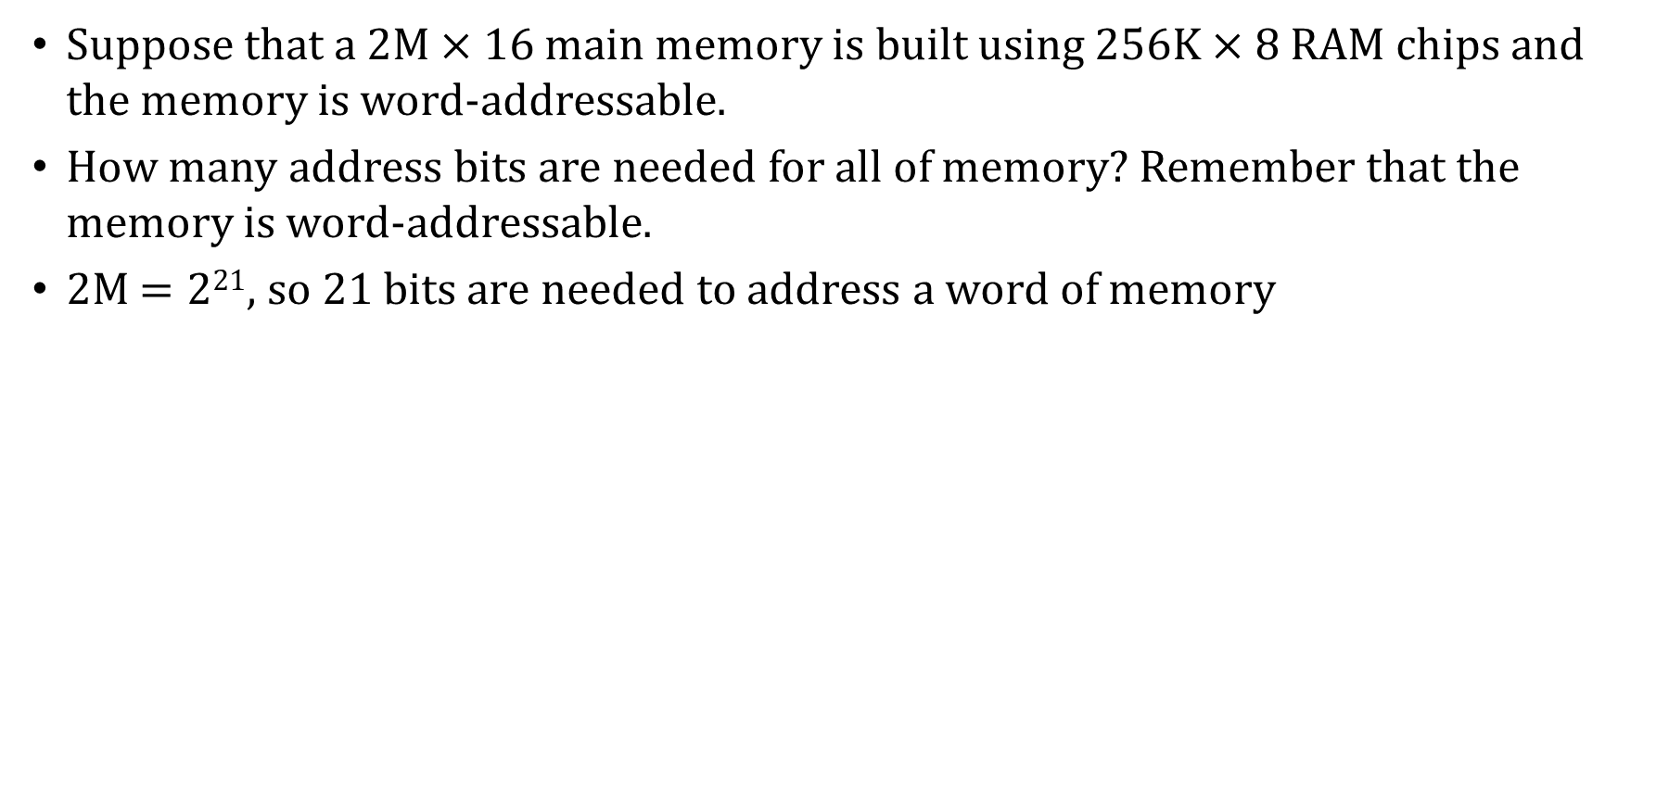
Memory Organization: Example #8
Suppose that a 2M $×$ 16 main memory is built using 256K $×$ 8 RAM chips and the memory is word-addressable.
How many address bits are needed for all of memory? Remember that the memory is word-addressable.
2M $=221$, so 21 bits are needed to address a word of memory

Slide 24
Byte Address vs Word Address
When the memory cell size is 8 bits then corresponding address space is called Byte Address.
2x8 = address size = 1 bit
64x8 = address size is 6 bits = 2^6
256x8 = address size is 8 bits = 2^8 bits
4kx8 = 4 x 2^10 = 2^12 = 12 bits
Where 2, 64, 256 and 4K are the number of cell. 8 is the number of bit per 1 cell. Notice Address size is not be in 8 bits

Slide 25
Word Address
When the memory cell size is depends on word length of the process, then the corresponding address space is called word addressable memory or word address
2xw = word address size
64xw = word address size
256xw = word address size
Where 2, 64, 256 and 4K are the number of cell. 8 is the number of bit per 1 cell. The cell size must be equal to word length

Slide 26
Address continue
Computer data is in binary and represented into Bit, Nibble, Byte, Words
So Microprocess may have same Bit, Nibble, Byte but can store more words, such as 8 bit microprocess, bit, nibble, byte size will never change, but the word length will change such as in this case is 8 bit.
Similarly, 64 bit microprocess, bit, nibble, byte size will never change, but the word length will change such as in this case is 64 bit.

Slide 27
MARIE
We can now bring together many of the ideas that we have discussed to this point using a very simple model computer.
Our model computer, the Machine Architecture that is Really Intuitive and Easy, MARIE, was designed for the singular purpose of illustrating basic computer system concepts.
While this system is too simple to do anything useful in the real world, a deep understanding of its functions will enable you to comprehend system architectures that are much more complex.

Slide 28
MARIE
The MARIE architecture has the following characteristics:
Binary, two’s complement data representation.
Stored-program, fixed-word-length data and instructions.
4K words of word-addressable main memory.
16-bit data words.
16-bit instructions, 4 for the opcode and 12 for the address.
A 16-bit arithmetic logic unit (ALU).
Seven registers for control and data movement.

Slide 29
MARIE
MARIE’s seven registers are:
Accumulator, AC, a 16-bit register that holds a conditional operator (e.g., “less than”) or one operand of a two-operand instruction (e.g., “add”).
Memory address register, MAR, a 12-bit register that holds the memory address of an instruction or the operand of an instruction.
Memory buffer register, MBR, a 16-bit register that holds the data after its retrieval from, or before its placement, in memory.
Program counter, PC, a 12-bit register that holds the address of the next program instruction to be executed.
Instruction register, IR, which holds an instruction immediately preceding its execution.
Two registers for dealing with I/O, InReg and OutReg

Slide 30
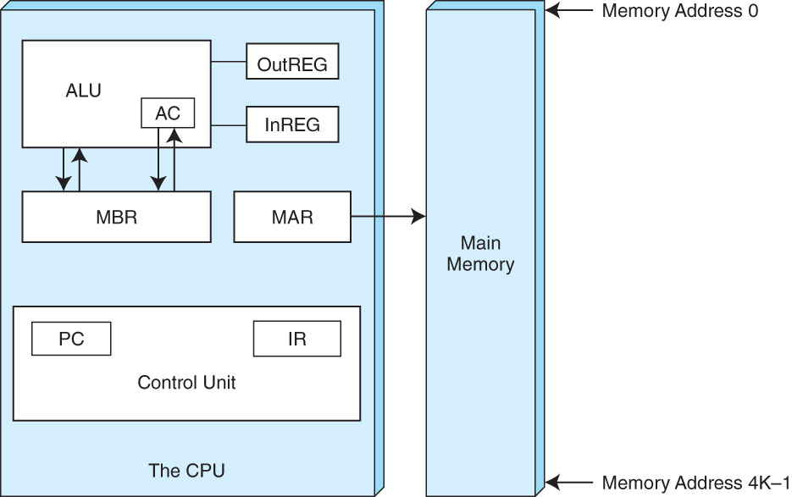
MARIE
This is the MARIE architecture shown graphically:

Slide 31
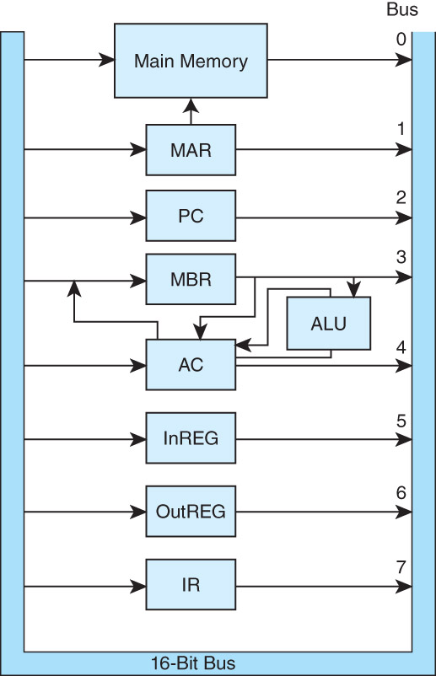
MARIE
The registers are interconnected, and connected with main memory through a common data bus.
Each device on the bus is identified by a unique number that is set on the control lines whenever that device is required to carry out an operation.
Separate connections are also provided between the accumulator and the memory buffer register, and the ALU and the accumulator and memory buffer register.
This permits data transfer between these devices without use of the main data bus.

Slide 32
MARIE
Modern computers have multiple general-purpose registers (the textbook calls them user-visible registers) that are available to the programmer to use in writing assembly-language programs
The PC, IR, MBR, etc. are not accessible by the programmer and can be used only for their very specific, intended purposes
A computer’s instruction set architecture (ISA) specifies the format of its instructions and the primitive operations that the machine can perform.
The ISA is an interface between a computer’s hardware and its software.
Some ISAs include hundreds of different instructions for processing data and controlling program execution.
The MARIE ISA consists of only thirteen instructions.

Slide 33
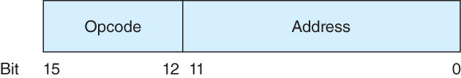
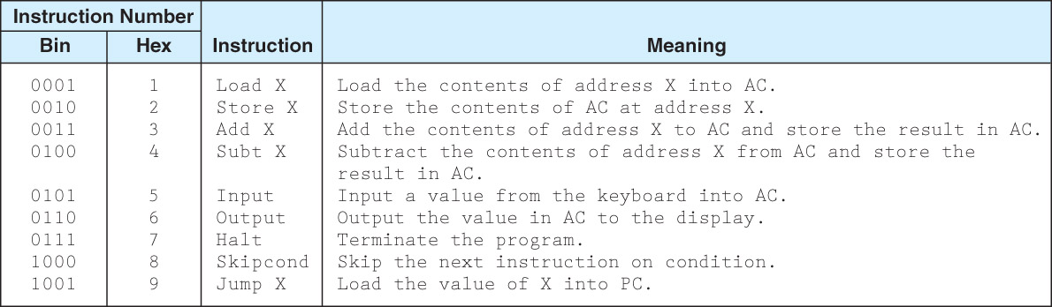
MARIE Instruction Set
This is the format of a MARIE instruction:
The fundamental MARIE instructions are:
Also, instruction #10 (hexadecimal A): Clear (sets AC to 0)

Slide 34
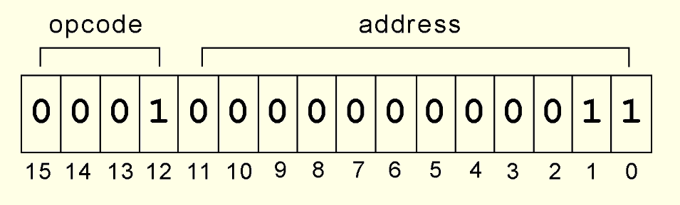
MARIE Instruction Set: LOAD Example
This is a bit pattern for a LOAD instruction as it would appear in the IR:
We see that the opcode is 1 and the address from which to load the data is 3.

Slide 35
MARIE Instruction Set: LOAD Example
3
2
1
0000 0000 0011 is stored in the MAR.
Data from that memory address is copied into the MBR.
Contents of the MBR are moved to AC.

Slide 36
SKIPCOND
SKIPCOND 400 | if AC == 0
SKIPCOND 800 | if AC > 0
SKIPCOND 000 | if AC < 0
If the SKIPCOND is true, the next (one) instruction will be skipped

Slide 37
SKIPCOND Example
ORG 100
LOAD num1
SKIPCOND 400
HALT
ADD num2
STORE answer
HALT
num1, Hex 5
num2, Hex 10
Answer, Hex 0

Slide 38
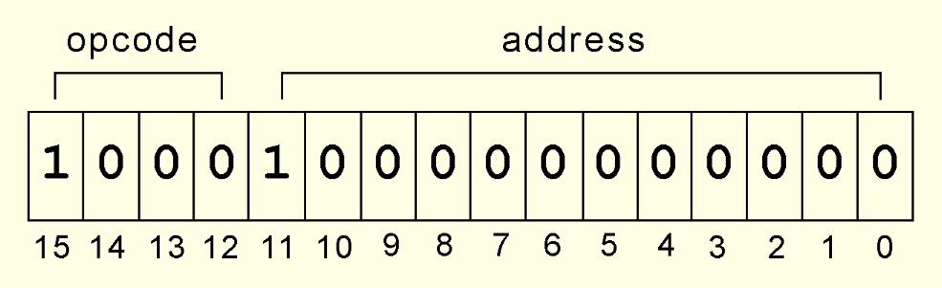
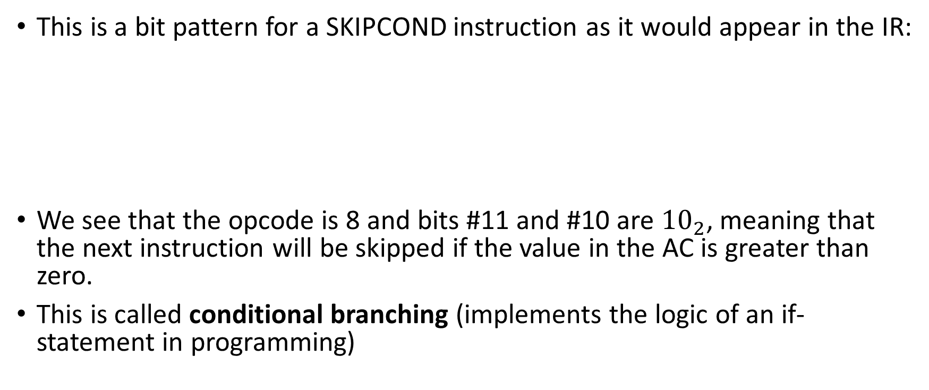
MARIE Instruction Set: SKIPCOND Example
This is a bit pattern for a SKIPCOND instruction as it would appear in the IR:
We see that the opcode is 8 and bits #11 and #10 are ${10}_{2}$, meaning that the next instruction will be skipped if the value in the AC is greater than zero.
This is called conditional branching (implements the logic of an if-statement in programming)
Conditions: 00: skip next instruction if AC < 0 01: skip next instruction if AC = 0 10: skip next instruction if AC > 0

Slide 39
Decoding MARIE Instructions: Example #1
Given the MARIE instruction set, decode the following MARIE machine language instruction, writing any numbers in hex:
0010000000000111
First separate the instruction into nibbles:
0010 0000 0000 0111
Opcode 0010 is for Store X (store the contents of AC at address X, where X is the 12 rightmost bits)
X is 0000 0000 0111
So the instruction is Store 007

Slide 40
Decoding MARIE Instructions: Example #2
Given the MARIE instruction set, decode the following MARIE machine language instruction, writing any numbers in hex:
1001000000001011
First separate the instruction into nibbles:
1001 0000 0000 1011
Opcode 1001 is for Jump X (load the value of X into the PC, where X is the 12 rightmost bits)
X is 0000 0000 1011
So the instruction is Jump 00B

Slide 41
MARIE Register Transfer Language
Each of our instructions actually consists of a sequence of smaller instructions called microoperations.
The exact sequence of microoperations that are carried out by an instruction can be specified using register transfer language (RTL).
In the MARIE RTL, we use the notation M[X] to indicate the actual data value stored in memory location X, and ← to indicate the transfer of bytes to a register or memory location.
The RTL for the LOAD instruction is:
MAR ← X
MBR ← M[MAR]
AC ← MBR
The RTL for the ADD instruction is:
MAR ← X
MBR ← M[MAR]
AC ← AC + MBR

Slide 42
MARIE Register Transfer Language
Recall that SKIPCOND skips the next instruction according to the value of the AC.
The RTL for the this instruction is the most complex in our instruction set:
If IR[11:10] = 00 then
If AC < 0 then PC ← PC + 1
else If IR[11:10] = 01 then
If AC = 0 then PC ← PC + 1
else If IR[11:10] = 10 then
If AC > 0 then PC ← PC + 1

Slide 43
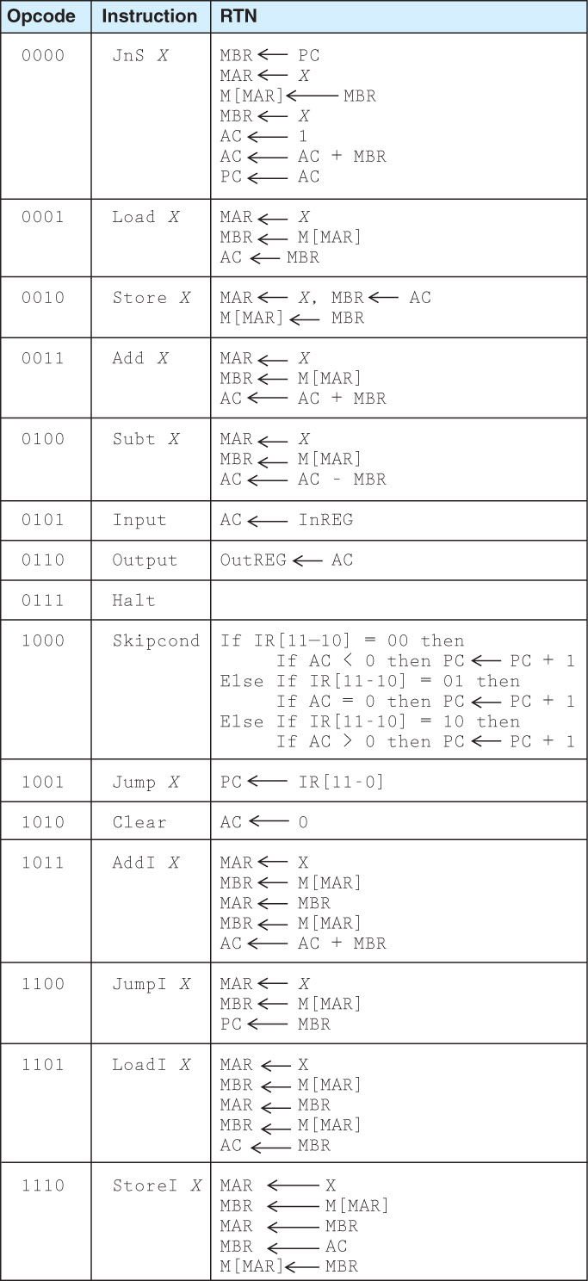
MARIE’s Instruction Set

Slide 44
MARIE’s Instruction Set (continued)

Slide 45
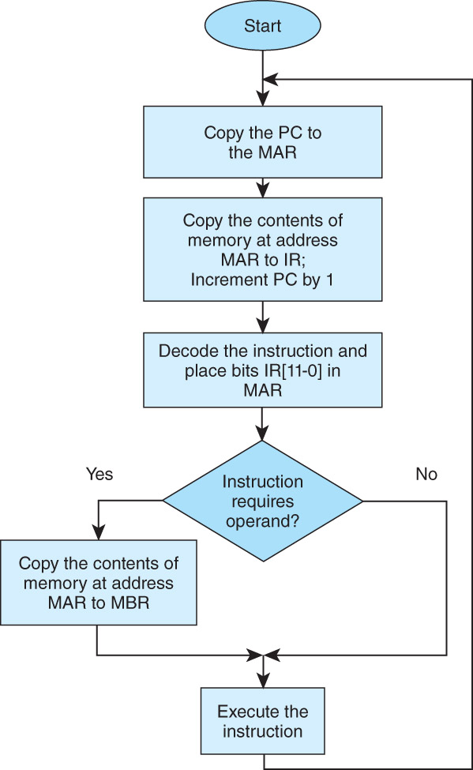
MARIE Instruction Processing
The fetch-decode-execute cycle is the series of steps that a computer carries out when it runs a program.
We first have to fetch an instruction from memory, and place it into the IR.
MAR ← PC, IR ← M[MAR], PC ← PC + 1
Once in the IR, the instruction is decoded to determine what needs to be done next.
MAR ← IR[11:0], then decode IR[15:12]
If a memory value (operand) is involved in the operation, it is retrieved and placed into the MBR.
With everything in place, the instruction is executed.

Slide 46
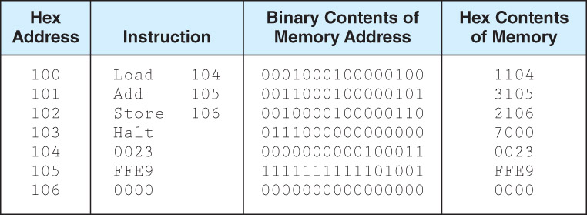
A Simple MARIE Program
Consider the simple MARIE program given below. We see a set of mnemonic instructions stored at addresses 0x100 – 0x106 (0x indicates hexadecimal)
The program adds the contents of the memory cells at address 0x104 and 0x105

Slide 47
A Simple MARIE Program
Let’s look at what happens inside the computer when our program runs. All values are hexadecimal. This is the LOAD 104 instruction:
Step | RTN | PC | IR | MAR | MBR | AC
(initial values) |  | 100 | --- | --- | --- | ---
Fetch | MAR ← PC | 100 | --- | 100 | --- | ---
 | IR ← M[MAR] | 100 | 1104 | 100 | --- | ---
 | PC ← PC + 1 | 101 | 1104 | 100 | --- | ---
Decode | MAR ← IR[11:0] | 101 | 1104 | 104 | --- | ---
 | (Decode IR[15:12]) | 101 | 1104 | 104 | --- | ---
Get operand | MBR ← M[MAR] | 101 | 1104 | 104 | 0023 | ---
Execute | AC ← MBR | 101 | 1104 | 104 | 0023 | 0023

Slide 48
A Simple MARIE Program
Let’s look at what happens inside the computer when our program runs. All values are hexadecimal. This is the LOAD 104 instruction:
Step
RTN
PC
IR
MAR
MBR
AC
(initial
100
---
---
---
---
values)
Fetch
MAR
ß
PC
100
---
100
---
---
IR
ß
M[MAR]
100
1104
100
---
---
PC
ß
PC + 1
101
1104
100
---
---
Decode
MAR
ß
IR[11:0]
101
1104
104
---
---
(Decode IR[15:12])
101
1104
104
---
---
Get operand
MBR
ß
M[MAR]
101
1104
104
0023
---
Execute
AC
ß
MBR
101
1104
104
0023
0023

Slide 49
A Simple MARIE Program
Our second instruction is ADD 105:
Step | RTN | PC | IR | MAR | MBR | AC
(initial values) |  | 101 | 1104 | 104 | 0023 | 0023
Fetch | MAR ← PC | 101 | 1104 | 101 | 0023 | 0023
 | IR ← M[MAR] | 101 | 3105 | 101 | 0023 | 0023
 | PC ← PC + 1 | 102 | 3105 | 101 | 0023 | 0023
Decode | MAR ← IR[11:0] | 102 | 3105 | 105 | 0023 | 0023
 | (Decode IR[15:12]) | 102 | 3105 | 105 | 0023 | 0023
Get operand | MBR ← M[MAR] | 102 | 3105 | 105 | FFE9 | 0023
Execute | AC ← AC + MBR | 102 | 3105 | 105 | FFE9 | 000C

Slide 50
A Simple MARIE Program Our second instruction is ADD 105:
Step
RTN
PC
IR
MAR
MBR
AC
(initial
101
1104
104
0023
0023
values)
Fetch
MAR
ß
PC
101
1104
101
0023
0023
IR
ß
M[MAR]
101
3105
101
0023
0023
PC
ß
PC + 1
102
3105
101
0023
0023
Decode
MAR
ß
IR[11:0]
102
3105
105
0023
0023
(Decode IR[15:12])
102
3105
105
0023
0023
Get operand
MBR
ß
M[MAR]
102
3105
105
FFE9
0023
Execute
AC
ß
AC + MBR
102
3105
105
FFE9
000C

Slide 51
A Simple MARIE Program
Our third instruction is STORE 106:
Step | RTN | PC | IR | MAR | MBR | AC
(initial values) |  | 102 | 3105 | 105 | FFE9 | 000C
Fetch | MAR ← PC | 102 | 3105 | 102 | FFE9 | 000C
 | IR ← M[MAR] | 102 | 2106 | 102 | FFE9 | 000C
 | PC ← PC + 1 | 103 | 2106 | 102 | FFE9 | 000C
Decode | MAR ← IR[11:0] | 103 | 2106 | 106 | FFE9 | 000C
 | (Decode IR[15:12]) | 103 | 2106 | 106 | FFE9 | 000C
Get operand | (not necessary) | 103 | 2106 | 106 | FFE9 | 000C
Execute | MBR ← AC | 103 | 2106 | 106 | 000C | 000C
 | M[MAR] ← MBR | 103 | 2106 | 106 | 000C | 000C

Slide 52
A Simple MARIE Program
Our third instruction is STORE 106:
Step
RTN
PC
IR
MAR
MBR
AC
(initial
102
3105
105
FFE9
000C
values)
Fetch
MAR
ß
PC
102
3105
102
FFE9
000C
IR
ß
M[MAR]
102
2106
102
FFE9
000C
PC
ß
PC + 1
103
2106
102
FFE9
000C
Decode
MAR
ß
IR[11:0]
103
2106
106
FFE9
000C
(Decode IR[15:12])
103
2106
106
FFE9
000C
Get operand
(not necessary)
103
2106
106
FFE9
000C
Execute
MBR
ß
AC
103
2106
106
000C
000C
M[MAR]
ß
MBR
103
2106
106
000C
000C

Slide 53
Instruction Execution Example
SKIPCOND 400 (400₁₆ = 0100 0000 0000₂)
01 indicates that we will perform the test (AC = 0)
Step | RTN | PC | IR | MAR | MBR | AC
(initial values) |  | 102 | 410D | 10D | 0014 | FFF8
Fetch | MAR ← PC | 102 | 410D | 102 | 0014 | FFF8
 | IR ← M[MAR] | 102 | 8400 | 102 | 0014 | FFF8
 | PC ← PC + 1 | 103 | 8400 | 102 | 0014 | FFF8
Decode | MAR ← IR[11:0] | 103 | 8400 | 400 | 0014 | FFF8
 | (Decode IR[15:12]) | 103 | 8400 | 400 | 0014 | FFF8
Get operand | (not necessary) | 103 | 8400 | 400 | 0014 | FFF8
Execute | do nothing (AC ≠ 0) | 103 | 8400 | 400 | 0014 | FFF8
IR becomes 8400 because 8 is the opcode for SKIPCOND and 0x400 is the given operand to the instruction.

Slide 54
Instruction Execution Example
SKIPCOND 400 (400₁₆ = 0100 0000 0000₂)
01 indicates that we will perform the test (AC = 0)
Step
RTN
PC
IR
MAR
MBR
AC
(initial
102
410D
10D
0014
FFF8
values)
Fetch
MAR
ß
PC
102
410D
102
0014
FFF8
IR
ß
M[MAR]
102
8400
102
0014
FFF8
IR becomes 8400 because 8 is the opcode for SKIPCOND and 0x400 is the given operand to the instruction.
PC
ß
PC + 1
103
8400
102
0014
FFF8
Decode
MAR
ß
IR[11:0]
103
8400
400
0014
FFF8
(Decode IR[15:12])
103
8400
400
0014
FFF8
Get operand
(not necessary)
103
8400
400
0014
FFF8
Execute
do
nothing (AC
≠
0)
103
8400
400
0014
FFF8

Slide 55
A Discussion on Assemblers
Mnemonic instructions, such as LOAD 104, are easy for humans to write and understand.
They are impossible for computers to understand.
Assemblers translate instructions that are comprehensible to humans into the machine language that is comprehensible to computers
There is often a one-to-one correspondence between assembly language instructions and machine language instructions

Slide 56
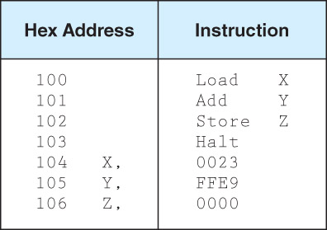
A Discussion on Assemblers
Assemblers create an object program file from mnemonic source code in two passes.
During the first pass, the assembler assembles as much of the program as it can, while it builds a symbol table that contains memory references for all symbols in the program.
During the second pass, the instructions are completed using the values from the symbol table.

Slide 57
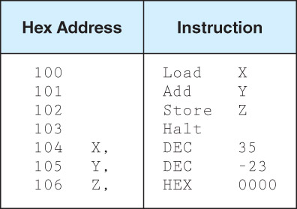
A Discussion on Assemblers
Consider our example program at the right.
Note that we have included two directives, HEX and DEC, that specify the radix of the constants.
It can be more convenient at times to provide values in base 10. The assembler takes care of the base conversion for us.

Slide 58
Interrupts
The normal execution of a program is altered when an event of higher-priority occurs. The CPU is alerted to such an event through an interrupt.
Interrupts can be triggered by special events of some kind
A user break (e.g., Control+C) is issued
I/O is requested by the user or a program
A critical error occurs
A mathematical error occurs (e.g., division by 0)
Software interrupts are also called traps.
Each interrupt is associated with a procedure that directs the actions of the CPU when an interrupt occurs.

Slide 59
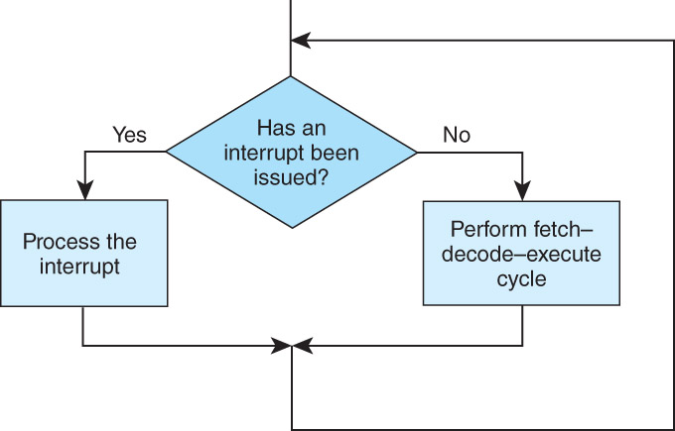
Interrupts
All computers provide a way of interrupting the fetch-decode-execute cycle.
Interrupt processing involves adding another step to the fetch-decode-execute cycle as shown on the right.

Slide 60
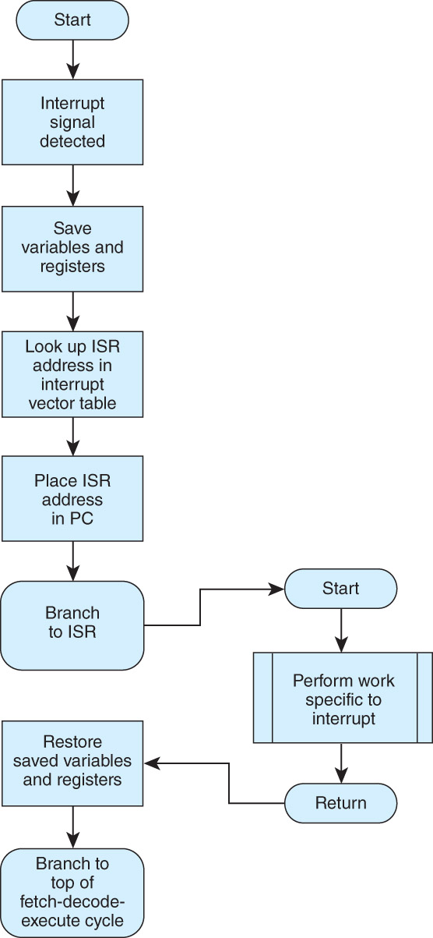
Interrupts
ISR is Interrupt Service Routine, which is a short program of sorts that handles a particular kind of interrupt
For general-purpose systems, it is common to disable all interrupts during the time in which an interrupt is being processed.
Interrupts that are ignored in this case are called maskable.
Nonmaskable interrupts are those interrupts that must be processed in order to keep the system in a stable condition.

Slide 61
Interrupts
Interrupts are very useful in processing I/O.
The I/O device interrupts the CPU when input is ready to be processed by the CPU
MARIE, being the simplest of simple systems, uses a modified form of programmed I/O, also called polling
All output is placed in an output register, OutREG
The CPU polls the input register, InREG, until input is sensed, at which time the value is copied into the accumulator.
Polling wastes time that interrupt-driven I/O avoids

Slide 62
Real-world Architectures
MARIE shares many features with modern architectures but it is not an accurate depiction of them.
In the following slides, we briefly examine two machine architectures.
We will look at an Intel architecture, which is a CISC machine and MIPS, which is a RISC machine.
CISC is an acronym for complex instruction set computer.
RISC stands for reduced instruction set computer.
CISC architectures feature a large variety of instructions, whereas RISC architectures provide a comparatively smaller set of much simpler instructions
CISC CPUs require much more complex circuitry.
Programs created for RISC CPUs tend to be significantly longer than those created for CISC CPUs.

Slide 63
Real-world Architectures
The classic Intel architecture, the 8086, was released in 1979. It is a CISC architecture.
It was adopted by IBM for its famed PC, which was released in 1981.
The 8086 operated on 16-bit data words and supported 20-bit memory addresses.
Later, to lower costs, the 8-bit 8088 was introduced. Like the 8086, it used 20-bit memory addresses.
So the maximum memory size for these machines was about 1 MB only!
The 8086 had four 16-bit general-purpose registers
The 8086 had no built in floating-point processing.
In 1980, Intel released the 8087 numeric coprocessor, but few users elected to install them because of their high cost.

Slide 64
Real-world Architectures
In 1985, Intel introduced the 32-bit 80386.
It also had no built-in floating-point unit.
The 80486, introduced in 1989, was an 80386 that had built-in floating-point processing and cache memory.
The 80386 and 80486 offered downward compatibility with the 8086 and 8088.
Software written for the smaller-word systems was directed to use the lower 16 bits of the 32-bit registers.

Slide 65
Real-world Architectures
Intel’s Pentium 4 introduced a brand new NetBurst architecture.
Speed enhancing features include:
Hyperthreading (a single physical CPU core has two logical cores that can be independently scheduled)
Improved pipelining, to execute multiple instructions simultaneously
Execution trace cache (holds decoded instructions for possible reuse)
Faster system bus
Intel these days marries many of the ideas of RISC architectures with CISC microprocessors

Slide 66
Real-world Architectures
The MIPS family of CPUs has been one of the most successful in its class.
In 1986 the first MIPS CPU was announced.
It had a 32-bit word size and could address 4GB of memory.
Over the years, MIPS processors have been used in general-purpose computers, game consoles and networking equipment (e.g., network routers).
The MIPS architecture now offers 32-bit and 64-bit versions.
The original MIPS architecture had only 55 different instructions, as compared with the 8086 which had over 100.
MIPS was designed with performance in mind: it is a load/store architecture, meaning that only the load and store instructions can access memory.
The large number of registers in the MIPS architecture keeps bus traffic to a minimum.

